Slide 1
Orthogonality and Least Squares
5.2 Orthogonal Sets
Bumhee Cho

Slide 2

Orthogonal Set
A set of vectors {u₁,…, u_{p}} in ℝ^{n} is said to be an orthogonal set if each pair of distinct vectors from the set is orthogonal, that is,
if u_{i}⋅u_{j} = 0 whenever i ≠ j.
?
Example 1
!
u₁ = (3, 1, 1), u₂ = (-1, 2, 1), u₃ = (-1/2, -2, 7/2)
u₁⋅u₂ = 0
u₁⋅u₃ = 0
u₂⋅u₃ = 0

Slide 3
Theorem 4.
If S = {u₁,…, u_{p}} is an orthogonal set of nonzero vectors in ℝ^{n}, then
S is linearly independent and hence is a basis for the subspace spanned by S.
c₁u₁ + ⋯ + c_{p}u_{p} = 0
(c₁u₁ + ⋯ + c_{p}u_{p})⋅u₁ = 0⋅u₁
c₁u₁⋅u₁ = 0
c₁ = 0
⋯
c_{p} = 0

Slide 4

Orthogonal Basis
An orthogonal basis for a subspace W of ℝ^{n} is a basis for W that is also an orthogonal set.

Slide 5
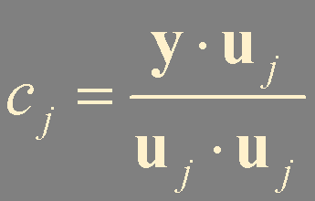

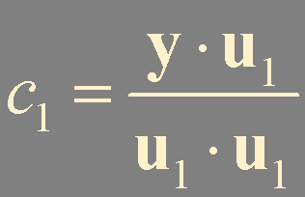
Theorem 5.
Let {u₁,…, u_{p}} be an orthogonal basis for a subspace W of ℝ^{n}. For each y in W, the weights in the linear combination
y = c₁u₁ + ⋯ + c_{p}u_{p}
are given by
y⋅u₁ = (c₁u₁ + ⋯ + c_{p}u_{p})⋅u₁
y⋅u₁ = c₁u₁⋅u₁

Slide 6
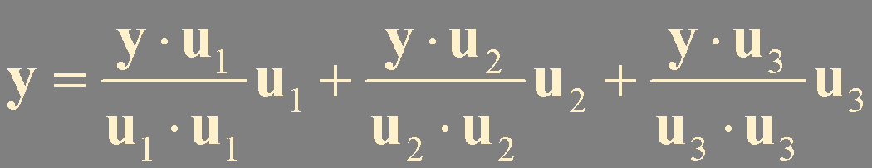
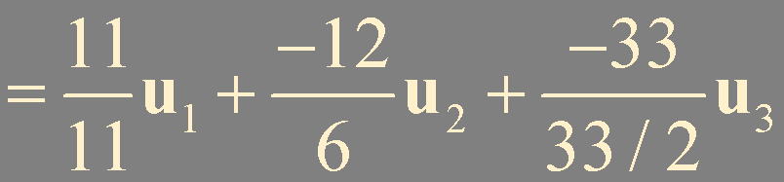

!
Example 2
?
Let u₁ = (3, 1, 1), u₂ = (-1, 2, 1), and u₃ = (-1/2, -2, 7/2), then the set S = {u₁, u₂, u₃} is an orthogonal basis for ℝ³. Express the vector y = (6, 1, -8) as a linear combination of the vectors in S.
y⋅u₁ = 11
u₁⋅u₁ = 11
[A y] = [u₁ u₂ u₃ y]
u₂⋅u₂ = 6
[A y] ~ [I c]
y⋅u₂ = -12
y⋅u₃ = -33
u₃⋅u₃ = 33/2

Slide 7

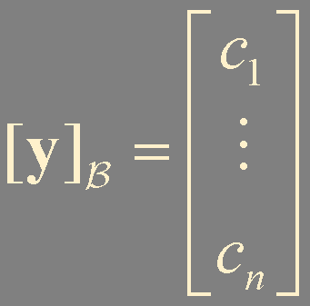
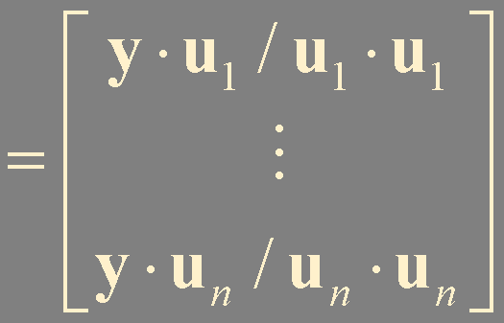
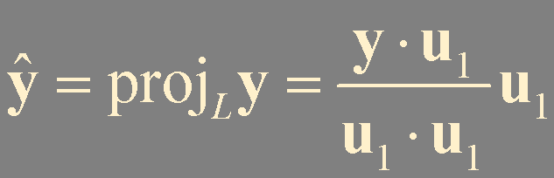

Orthogonal Projection
Let B = {u₁,…, u_{n}} orthogonal basis for ℝ^{n}
y
y = c₁u₁ + ⋯ + c_{n}u_{n}
L
u₂
u₁
c₁u₁
0
the orthogonal projection of y onto u₁ (or onto L)
the component of y orthogonal to u₁

Slide 8
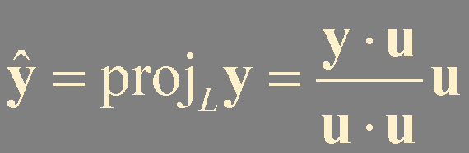
Given a nonzero vector u in ℝ^{n}
y in ℝ^{n} is decomposed into two vectors
L is Span {u}
z is the component of y orthogonal to u

Slide 9
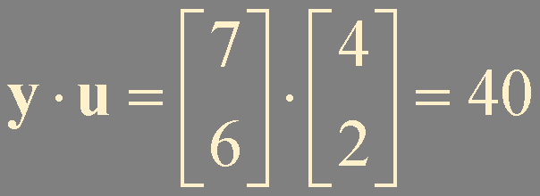
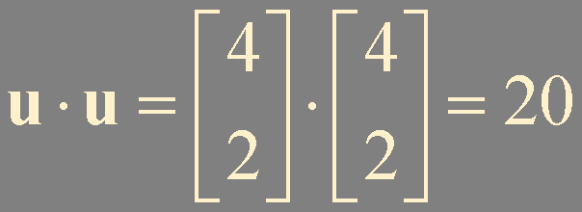
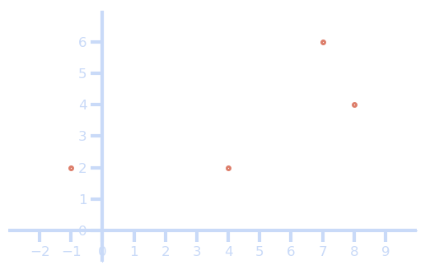

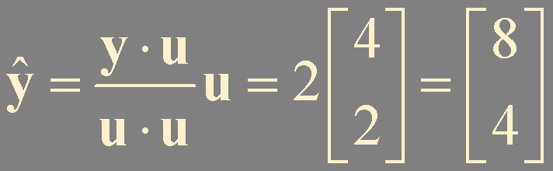
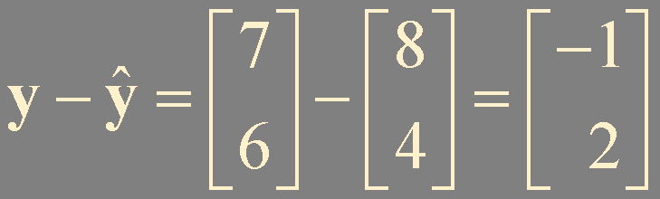

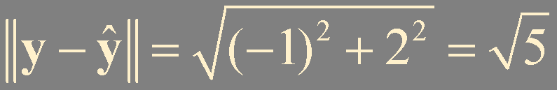
?
Example 3
!
Let y = (7, 6) and u = (4, 2). Find the orthogonal projection of y onto u. Then write y as the sum of two orthogonal vectors, one in Span {u} and one orthogonal to u.
y
u
!
Example 4
?
Find the distance from y to Span {u}.

Slide 10
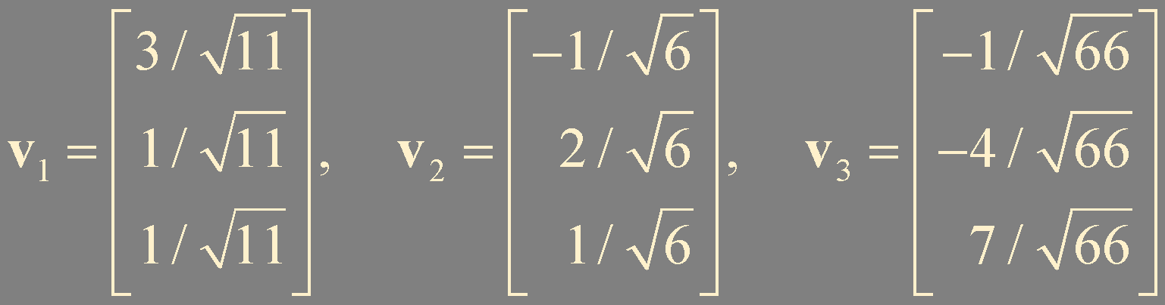
Orthonormal Sets
A set {u₁,…, u_{p}} is an orthonormal set if it is an orthogonal set of unit vectors.
!
Example 5
?
Show that {v₁, v₂, v₃} is an orthonormal basis of ℝ³, where

Slide 11
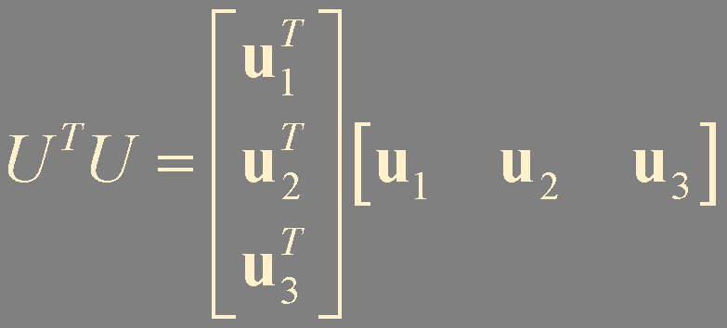
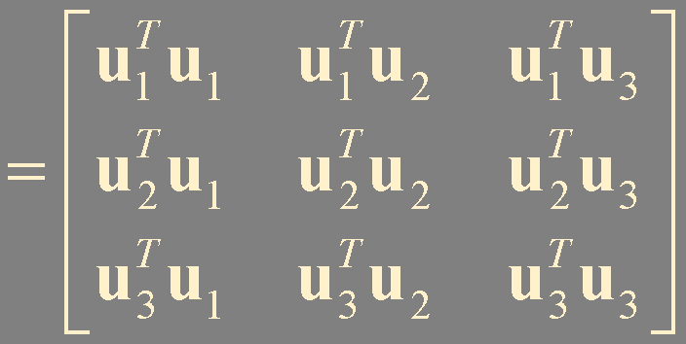

Theorem 6.
An m × n matrix U has orthonormal columns if and only if
U ^{T}U = I.

Slide 12
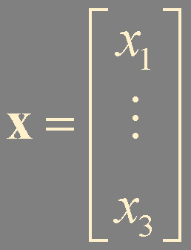
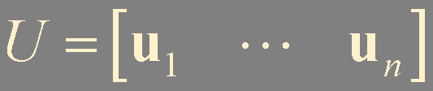
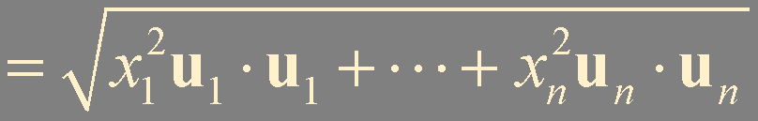
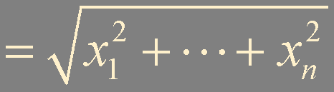
Theorem 7.
Let U be an m × n matrix with orthonormal columns, and let x and y be in ℝ^{n}. Then
a. ||Ux|| = ||x||
b. (Ux)⋅(Uy) = x⋅y
c. (Ux)⋅(Uy) = 0 if and only if x⋅y = 0
(Ux)⋅(Uy) = (Ux)^{T}(Uy)
= x^{T}U^{T}Uy
= x^{T}y

Slide 13
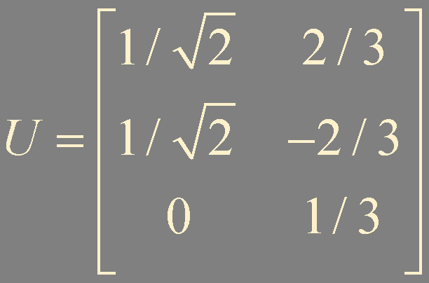
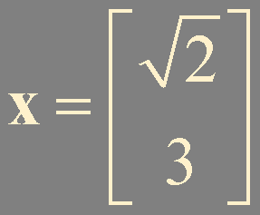

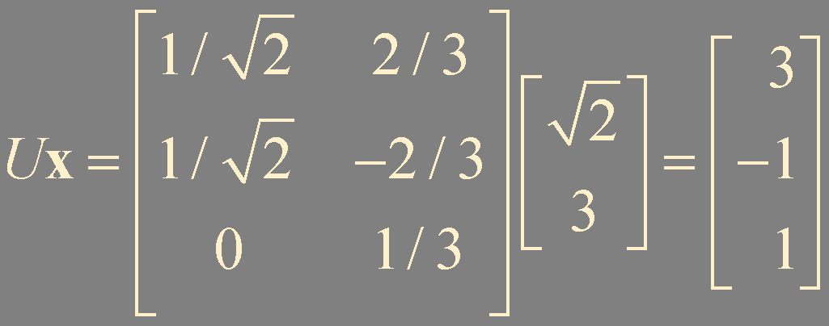

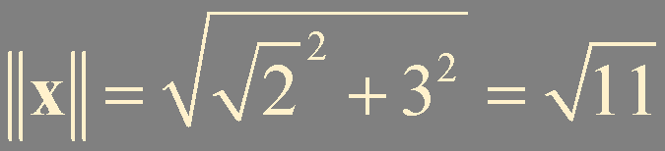
!
Example 6
?
Let and . Verify ||Ux|| = ||x||.

Slide 14
Summary
Orthogonal set
Orthogonal basis
Orthogonal projection
Orthonormal set

